Slide 1


Team Details
  Team name: Royal Stack
  Team leader name: SATHISHKUMAR S
  Problem Statement: Retail & Commerce. Small and mid-size Indian retailers run on billing software: shoppers get no help in the aisle, owners guess their reorders, and nothing is connected. Royal Stack is one AI commerce agent on one inventory truth, serving the store visit, the online shop and the owner's dashboard.

Slide 2
Brief about the idea
Royal Stack: one AI commerce agent, one inventory truth.
One Gemini agent team serves the shopper in the store and online and runs the owner's inventory on one stock record, filled from the software the shop already runs. Two shopper experiences share one session, cart and checkout: the store visit (entrance QR, voice assistant with map and aisle directions, scan to add, exit kiosk) and the online shop (product-first home, product sheet with label facts and price comparison, cart, checkout). The owner runs forecasts, reorders, demand signals, customers and integrations on one dashboard.
In the aisle
Online
In the back office
The gap: No one to ask, no answer in the shopper's language, a queue at the end.
What we built: The store visit: entrance QR, no install; voice assistant in 25 languages with map and aisle directions; scan to add; exit kiosk with seven verification layers.
The gap: A small shop's online store, when it has one, does not know the shelf stock and has no assistant.
What we built: The online shop on the same session, cart and checkout: categories, deals, trending from real orders, picks for signed-in shoppers, label facts with citations, price comparison across providers.
The gap: Reorders from memory, demand noticed after the sale is lost, stock data locked inside billing software.
What we built: Owner dashboard with BigQuery ML forecasts, reorder drafts with a Gemini rationale, demand signals and customer segments; a connector agent that brings files, sheets, API feeds, databases and MCP servers in.
Everything on these slides is deployed at royastacxk-aibuildercup.web.app on Google Cloud with Gemini. Nothing here is planned-only.

Slide 3
Opportunities
How it differs from existing ideas
Most retail AI is a chatbot on one channel. Royal Stack is an agent team on Google ADK (a coordinator plus specialists on Gemini) that serves the store visit, the online shop and the owner on one inventory truth.
Real-time speech to speech on Gemini Live in 25 languages; typed lines join the same spoken conversation; every fact comes from a tool over the live catalog.
The shop's catalog is itself an MCP server (/mcp/stores/{store_id}), and the shop can connect any MCP provider to compare prices.
How it solves the problem
Shoppers get stock, price, aisle directions and label facts with citations from tools, never guessed; out-of-stock items come with alternatives.
Owners get ARIMA_PLUS forecasts, days of cover, reorder drafts grouped by supplier with a rationale, demand signals and customer segments; nothing changes without approval.
Inventory comes from what the shop already has: Excel template, Google Sheets copy, checked upload, scan, API feeds, databases, MCP servers. One taxonomy chain is applied at every import, so search, the map and spoken directions agree.
USP
The model talks, code decides: prices, stock, discounts, points and exit verdicts are code inside transactions; Gemini handles language, vision, grounding and proposals.
One session, cart and checkout across the store visit and the online shop.
Self-service: a shop registers, uploads its inventory and is live. 380 backend and 32 frontend tests; every control mapped in docs/security.md.
Judging criteria addressed here: innovation (25%) and problem alignment (25%); technical merit and GenAI use (40%) on the architecture and technology slides; UX (10%) on the screens.

Slide 4
List of features offered by the solution
Shopper: the store visit
Entrance QR, no app install; optional phone OTP sign-in for history, offers and points
Voice assistant on Gemini Live: real-time speech to speech, interruptible, 25 languages; typed lines join the conversation
Floor map with aisle, bay and side directions; aisle QRs update where you stand
Scan to add; offers apply themselves; points at checkout; sandbox payment; receipt QR
Exit kiosk: seven verification layers decide; Gemini vision only moves confidence
Shopper: the online shop
Product-first home: categories, deals, trending from real orders, picks for signed-in shoppers
Search by words, by section ("healthy food" lists that section) or by photo
Product sheet: quantity stepper, label facts from public sources with citations, price comparison across providers
Cart stepper; the same session, cart and checkout as the store visit
Assistant tools over the live catalog: search, section listing, store overview, navigation, cart, offers, product facts, compare prices
Owner dashboard
Today's sales; inventory with BigQuery ML ARIMA_PLUS forecasts and days of cover; product editor
Reorder drafts grouped by supplier with a Gemini rationale; approve or reject
Demand signals; customer segments (new, regular, VIP, at risk); offers; loss and shrink; exit checks; account settings
Inventory intake: Excel template, Google Sheets copy, checked upload (no accidental overwrite), add by hand or by scan
Integrations: connector agent for files, sheets, API feeds, databases and MCP servers (propose mapping, preview, confirm; credentials in Secret Manager); the catalog served as an MCP server
Taxonomy: product → category → subcategory → storage → department → floor block (Staples & Cooking; Snacks, Beverages & Sweets; Personal Care & Baby; Household, Pooja & Pets; Home, Kitchen & Hardware; Stationery, Toys & Sports; Fresh Produce; Clothing & Footwear; Chiller; Freezer), applied by rules at every import, shown on the map and spoken in directions.

Slide 5
Process flow diagram or Use-case diagram
Shopper, store visit
Scan the entrance QR
Ask by voice or text
Map and aisle directions
Scan to add
Offers and points apply
Pay, receipt QR
Exit kiosk: seven layers
Shopper, online shop (same session, cart and checkout)
Shop online, pick the shop
Home: categories, deals, trending, picks
Search by words, section or photo
Product sheet: facts, compare prices
Cart stepper
Checkout
Owner loop
Inventory in: template, sheet, upload, scan, connectors
Rules place every product (taxonomy)
Sales recorded, BigQuery nightly
ARIMA_PLUS forecast, days of cover
Reorder drafts by supplier with rationale
Owner approves; signals and segments feed offers
How a turn is answered
A coordinator with no tools routes each turn to a specialist (catalog, navigation, cart; for owners: briefing with two scouts in parallel and a writer, inventory planner, customers and offers, data connector, store ops). Specialists act only through tools over the live catalog; the screen renders tool results.
Rules decide at the exit
Receipt token, paid order, item count, line limit, high-value items, random audit, then a Gemini bag photo that only moves confidence and never blocks an exit. Staff review flags with a kiosk PIN; photos are never stored.

Slide 6
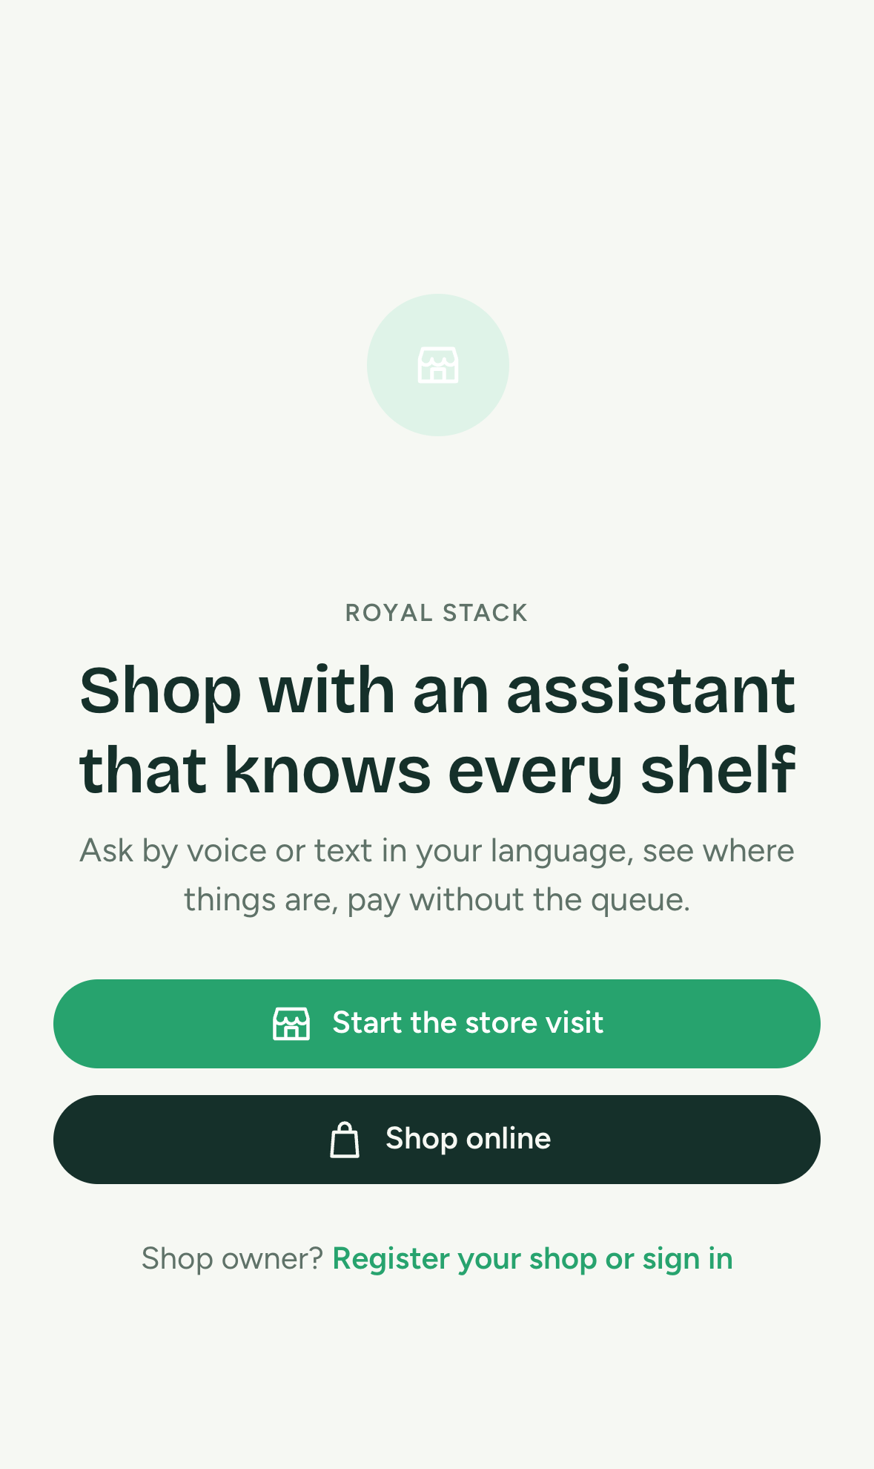
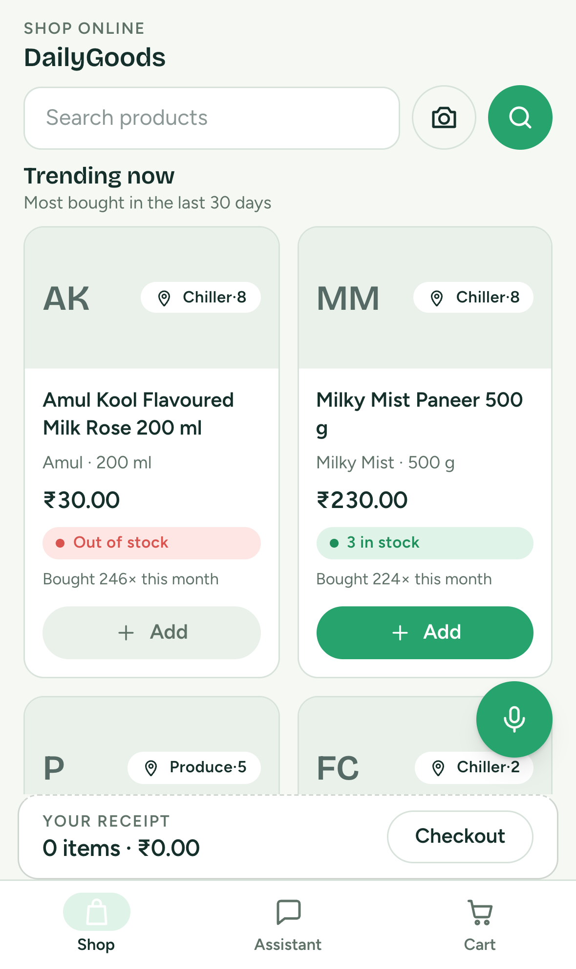
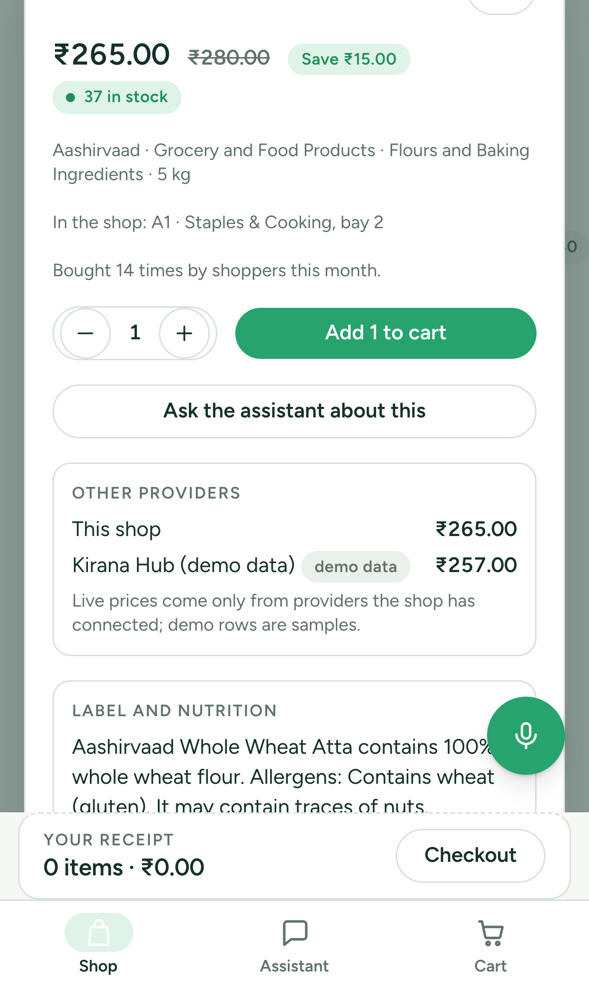
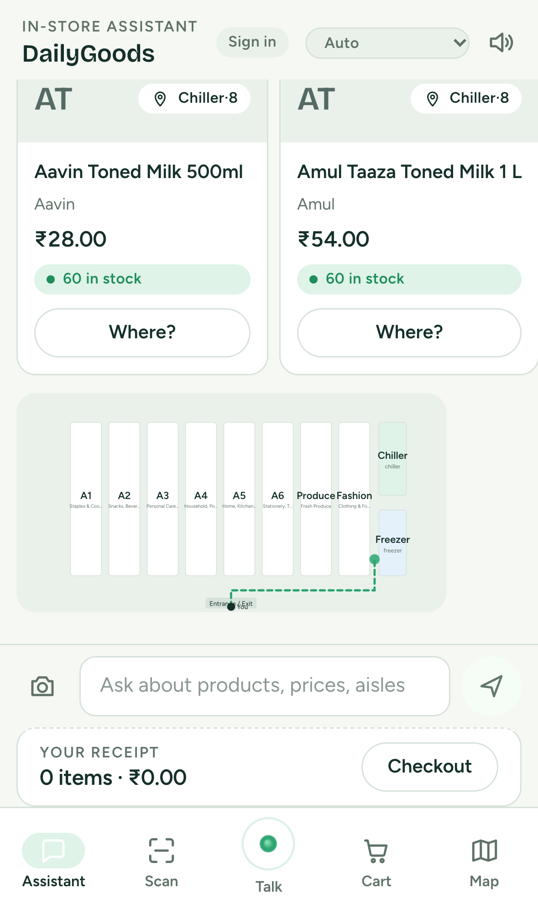
Wireframes/Mock diagrams of the proposed solution (optional)
Live screens of the deployed app on a phone, captured 18 Oct 2026 (no mock-ups).
Landing: two front doors, the store visit and the online shop
Online shop: categories, deals, trending from real orders
Product sheet: price comparison across providers, label facts with citations
Store visit: assistant answers from the catalog and lights the aisle on the map

Slide 7
Architecture diagram of the proposed solution
Clients
Shopper PWA on the phone (store visit and online shop) · Owner dashboard on laptop or phone · Exit kiosk on a tablet · Other agents over MCP. Static Next.js PWA on Firebase Hosting; Firebase Auth: Google and email for owners, phone OTP for shoppers who opt in.
Cloud Run: FastAPI (Python 3.12) with Google ADK 2.12 agent teams
Shopper coordinator → catalog, navigation, cart specialists; owner coordinator → briefing (two scouts in parallel, one writer), inventory planner, customers and offers, data connector, store ops
Gemini Live websocket bridge: speech to speech, echo guard, typed lines in the same session, transcripts in the spoken script
Connector agent and normalizer (files, Sheets, API feeds, databases, MCP); MCP servers for every store's catalog and for the demo provider
Taxonomy rules at every import; signed sync (HMAC, replay-safe); rate limits; audit on every change
Vertex AI · Gemini
Gemini 3.5 Flash: tools, vision, mapping, rationale
Gemini 3.1 Pro: heavier reasoning
Gemini Live 2.5 Flash: speech to speech
gemini-embedding-001: multilingual search
Google Search grounding: product facts with citations
Firestore
Inventory truth, orders, customers, points ledger, memory, audit; deny-all client rules
BigQuery ML
Sales history; ARIMA_PLUS forecasts per product and store, nightly
Cloud Scheduler
Forecast nightly, customers nightly, sync and connectors every 15 min
Secret Manager · Cloud TTS
Signing keys, connector credentials, MCP tokens; Text-to-Speech for the demo narration
Outside the platform
Billing software exports (Excel, CSV, JSON, PDF), Google Sheets, API feeds, Postgres/MySQL and MCP providers through the connector agent · Open Food Facts for barcodes · Razorpay (sandbox) for payment · GitHub Actions CI with the Firestore emulator, Cloud Build source deploys

Slide 8
Technologies to be used in the solution
Google Cloud and AI
Vertex AI Gemini 3.5 Flash (tools, vision, grounding, rationale) and Gemini 3.1 Pro
Gemini Live 2.5 Flash (speech to speech)
gemini-embedding-001 (search); Google Search grounding (product facts)
Google ADK 2.12: coordinator, specialist, parallel and sequential agents
Cloud Run, Cloud Build, Cloud Scheduler
Firestore; BigQuery ML (ARIMA_PLUS)
Secret Manager; Cloud Text-to-Speech (demo narration)
Firebase and web
Firebase Hosting (static PWA)
Firebase Auth: Google, email and password, phone OTP
Next.js 16, TypeScript, Tailwind v4, zustand
Web Audio and AudioWorklet for live voice
Barcode and QR scanning in the browser
Recharts, qrcode.react
vitest (32 tests), lint and static build in CI
Backend and data
Python 3.12, FastAPI, google-genai SDK
MCP over Streamable HTTP JSON-RPC: hosted servers and a guarded client
openpyxl (Excel template and upload), SQLAlchemy, psycopg, PyMySQL, httpx
HMAC-signed sync contract, outbox with retries
Open Food Facts for real barcodes
pytest on the Firestore emulator (380 tests), GitHub Actions CI
Design notes per module in docs/lld, control map in docs/security.md
Why these: Gemini for language, vision, grounding and proposals; Firestore transactions for anything that counts or pays; BigQuery ML for forecasts without an ML pipeline; Cloud Run so one shop costs a warm instance, not a server; MCP so other agents can shop the catalog.

Slide 9
Estimated implementation cost (optional)
Indicative monthly cost for one shop at pilot scale (about 300 visits a day, one warm API instance, asia-south1). List prices change; the usage lines scale with conversations.
Component | What drives it | Indicative cost per month
Cloud Run API | One warm instance (1 vCPU, 1 GiB), scales to three under load | ₹1,200 to ₹2,500
Gemini usage | Voice: about ₹5 per visit of 8 turns. Text: under ₹0.50 per question. Forecast rationale, mapping and product facts: a few paise each | ₹4,000 to ₹12,000 depending on voice share
Firestore | Catalog, carts, orders, customers, memory; mostly inside the free tier at this scale | ₹0 to ₹500
BigQuery ML | Nightly ARIMA_PLUS retraining per store, small tables | ₹0 to ₹300
Firebase Hosting and Auth | Static hosting, Google and email sign-in free; phone OTP per SMS beyond the free allowance | ₹0 to ₹500
Scheduler, Secret Manager, Build | Three jobs, a handful of secrets, source deploys | under ₹200
Total | Platform fixed cost plus usage; no per-seat licence, no hardware beyond a phone and an optional tablet | about ₹6,000 to ₹16,000

Slide 10
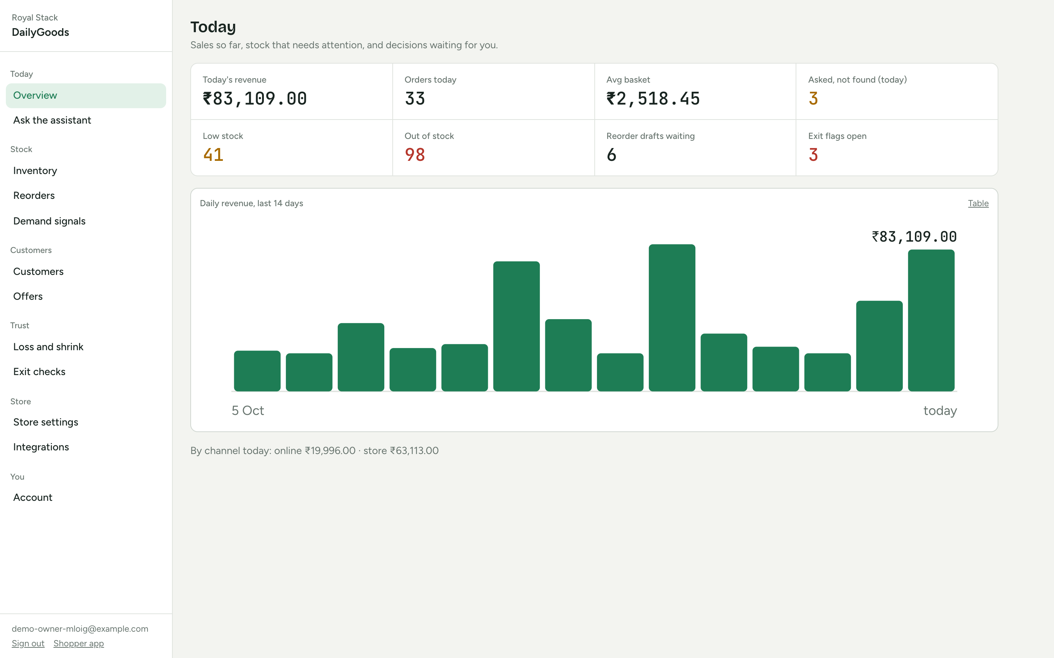
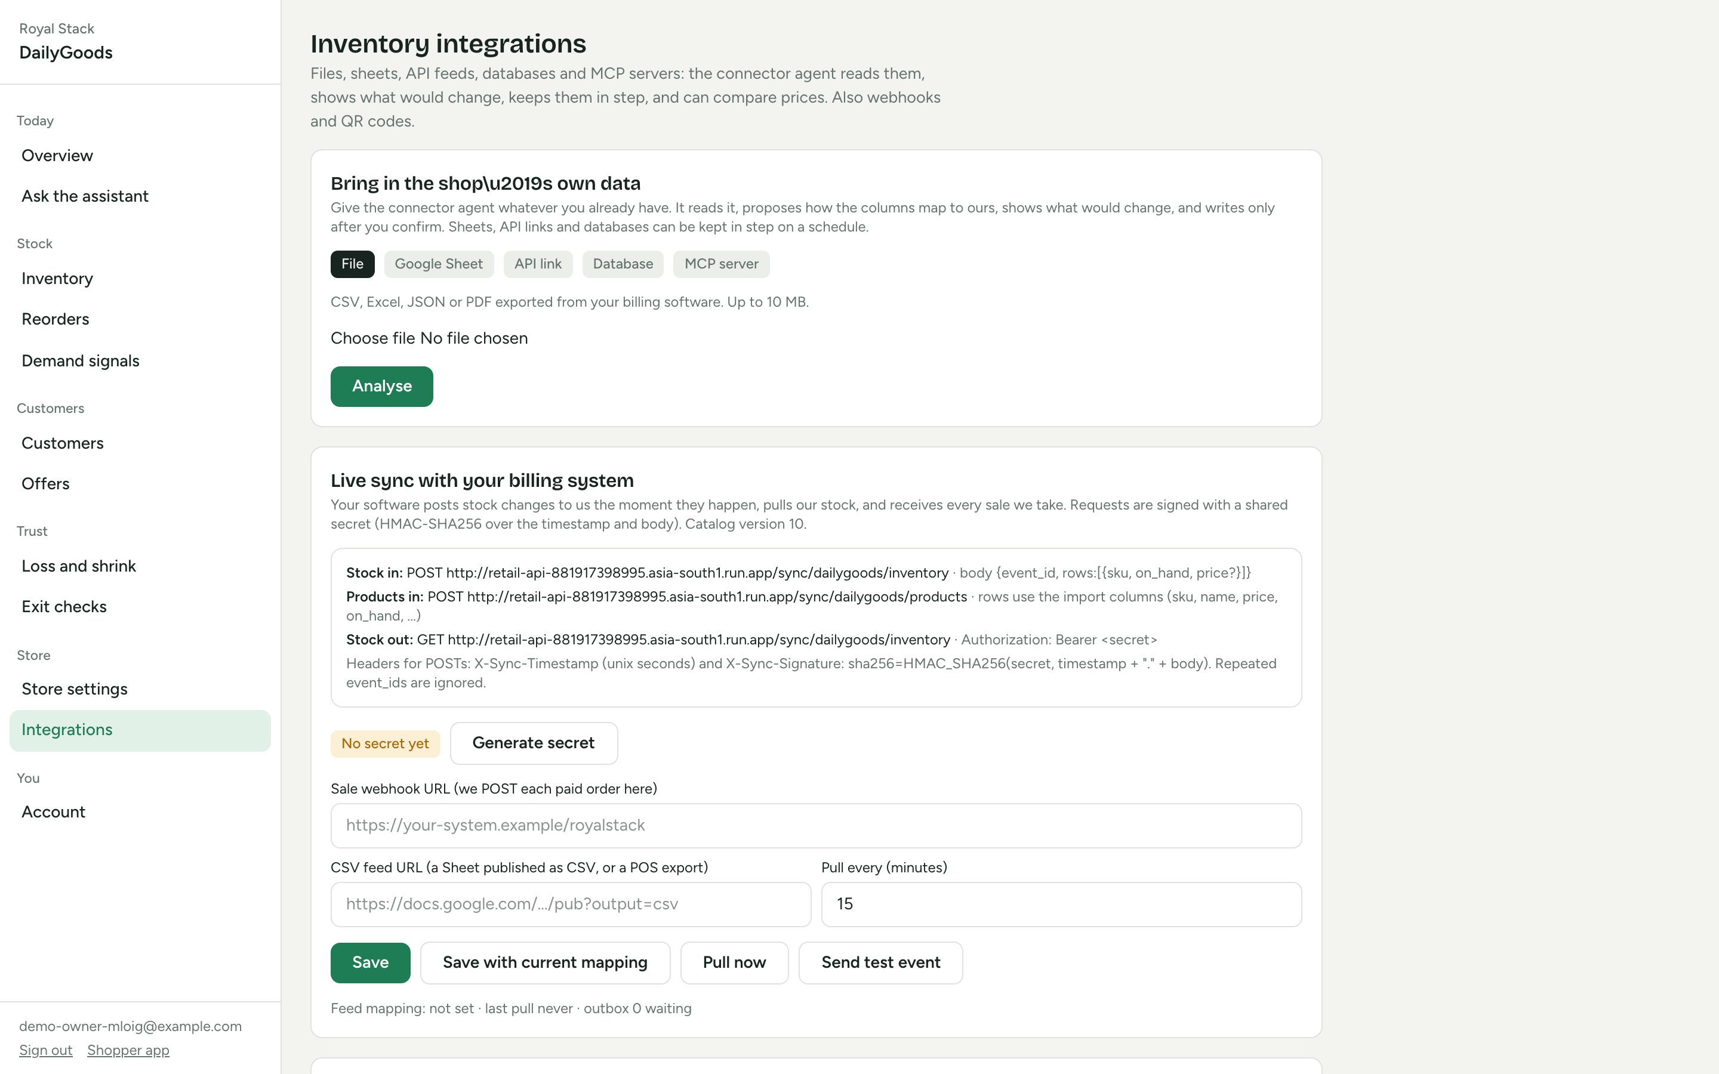
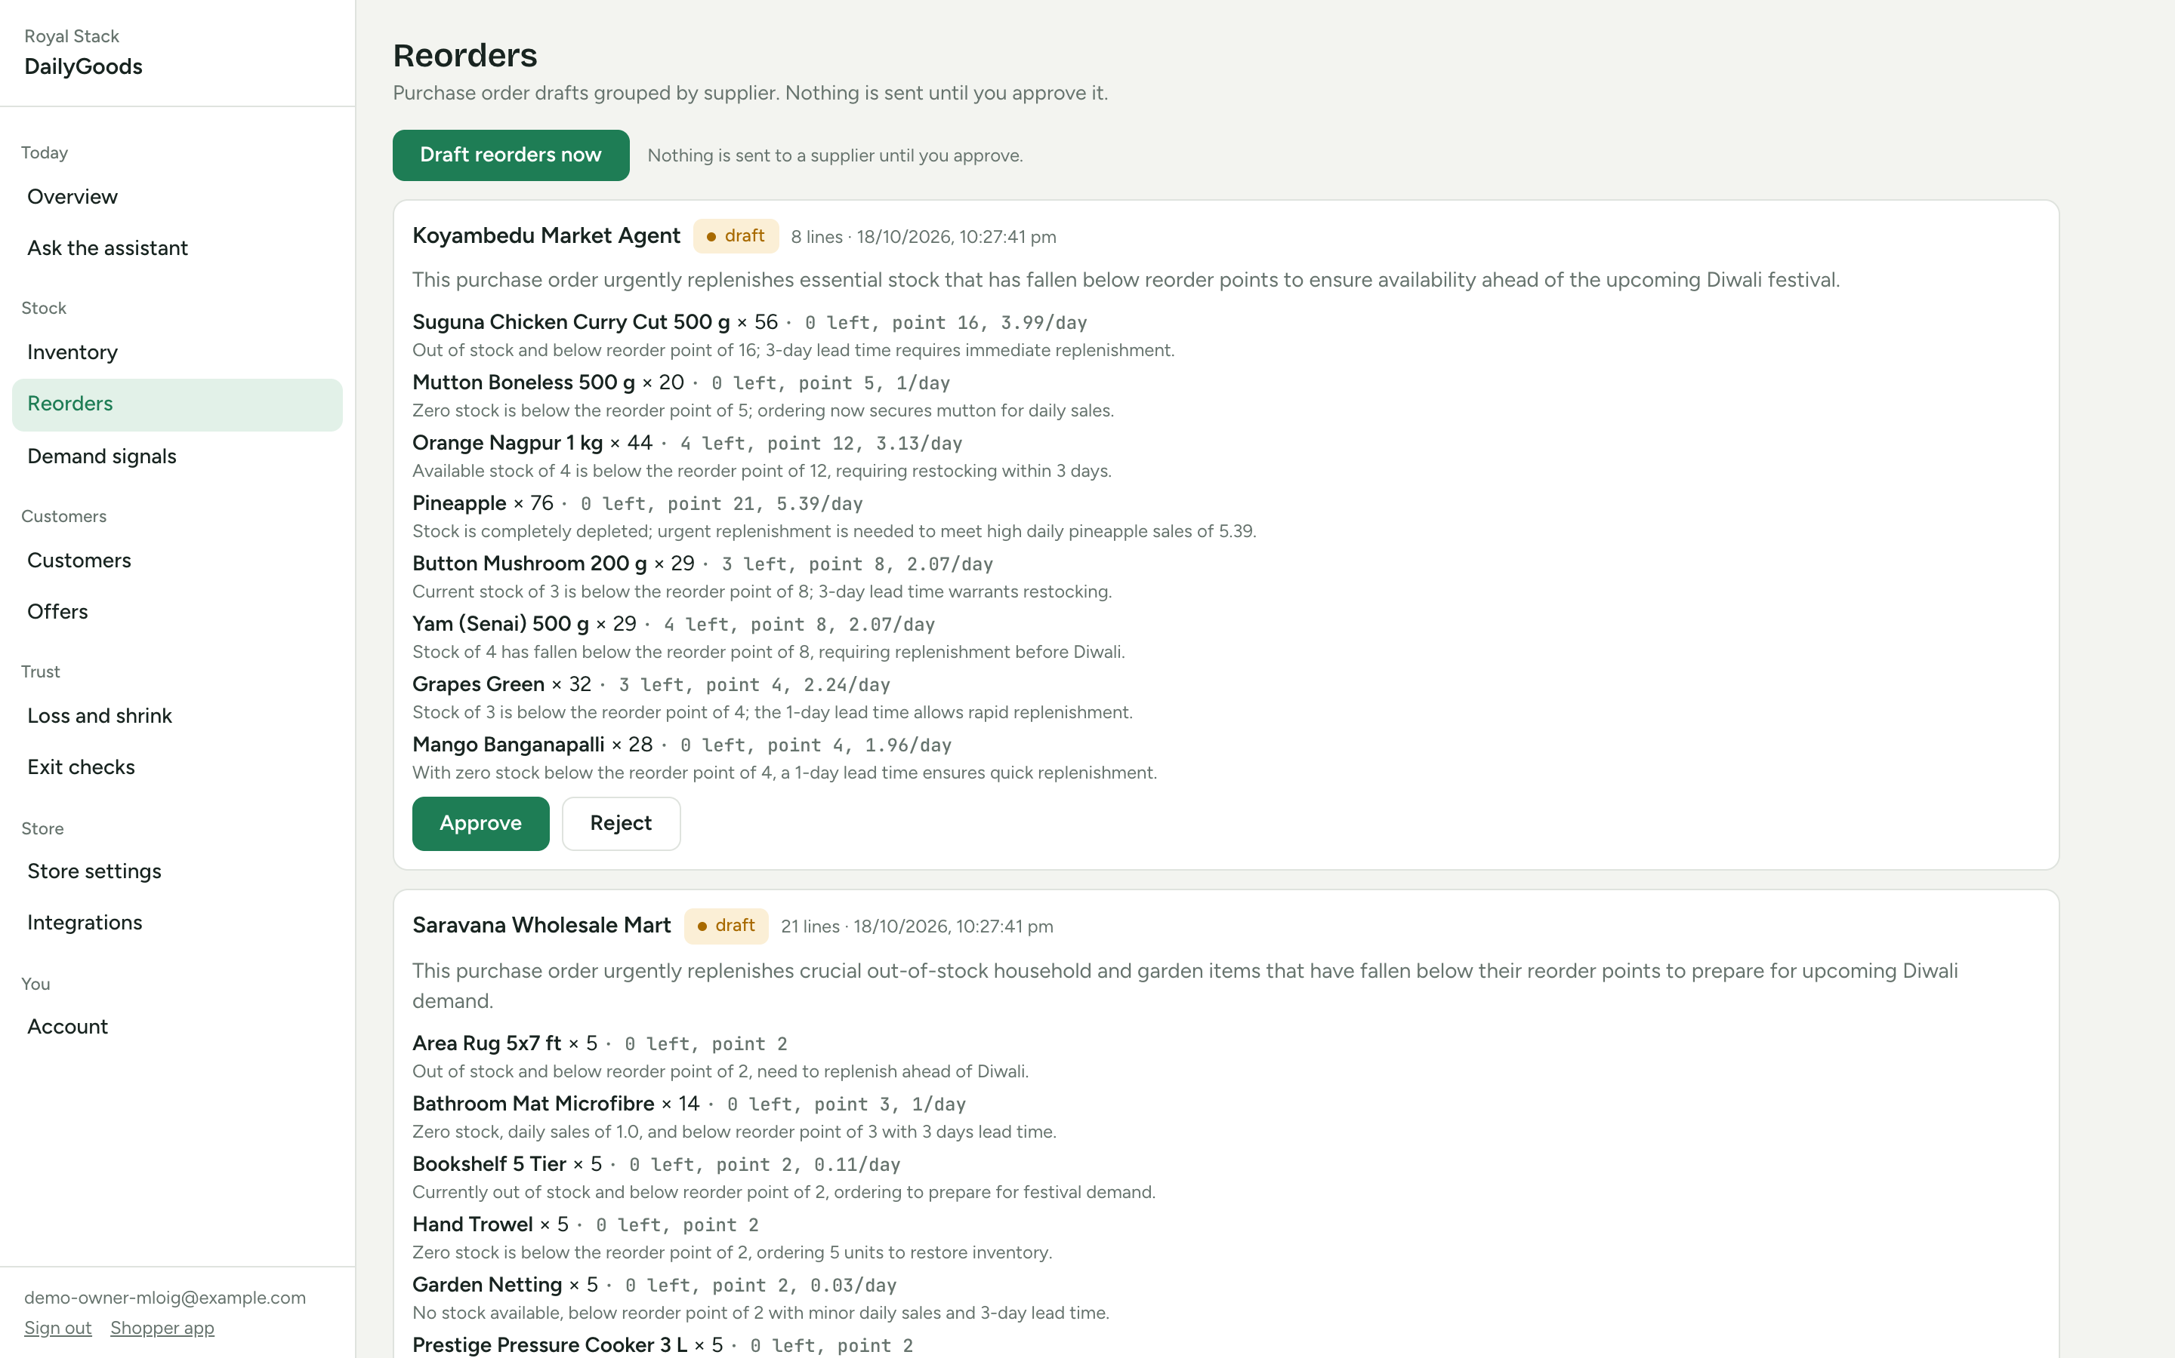
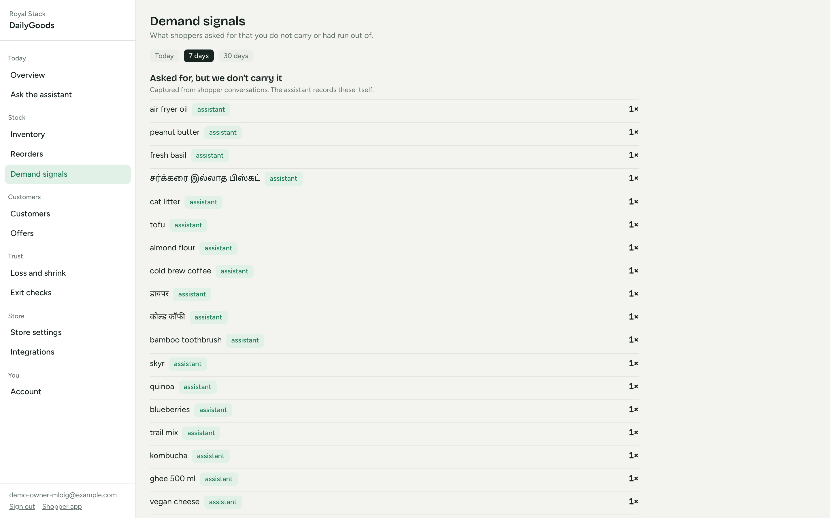
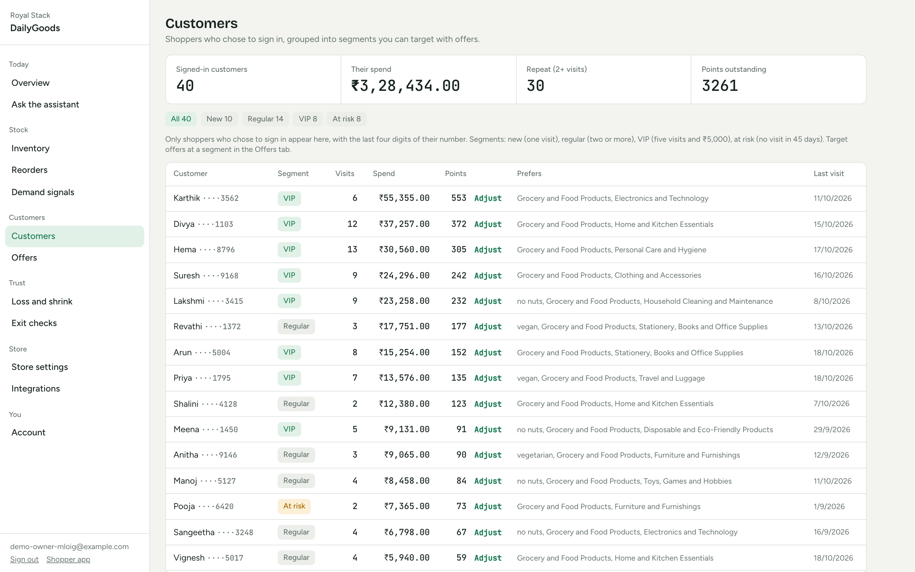
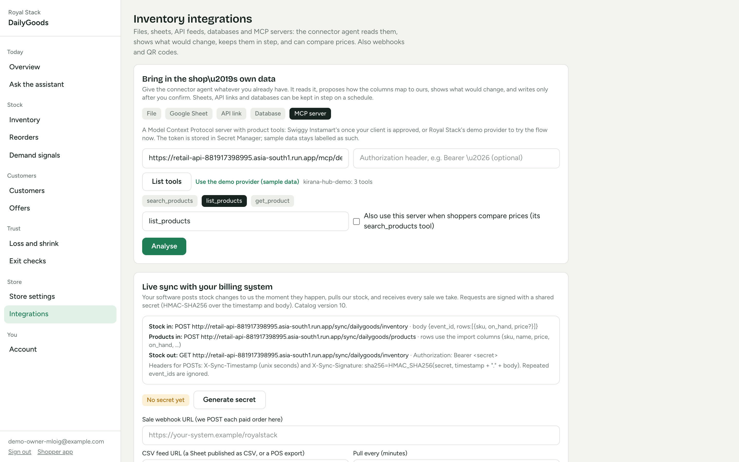
Snapshots of the prototype
Owner dashboard of the demo store DailyGoods, captured 18 Oct 2026 on a laptop; the phone screens are on the wireframes slide.
Today: sales so far, low stock, open decisions
Integrations: file, sheet, API, database, MCP
Reorders by supplier with a Gemini rationale
Demand signals: asked for but not carried
Customers: segments, spend, points
MCP source: list tools, preview, confirm

Slide 11
Prototype Performance report/Benchmarking
Measured on the deployed Cloud Run service on 18 Oct 2026 from a laptop in India; latencies are medians of three runs.
Measure | Result
Store catalog read (DailyGoods, 1,541 products) | 117 ms
Text question with tool calls: first visible event | 1.2 to 2.0 s
Text question: full streamed reply (search, navigation, cart add) | 5.9 to 9.3 s
Live voice: first spoken audio after the question | 1.8 s
Live voice: a 22-second spoken answer fully delivered | 5.0 s (plays while it streams)
Catalog refresh across API instances after a stock change | within 2 s (version counter)
Languages in the selector | 25, each tag verified against the live model; transcripts in the spoken script
Automated tests | 380 backend (pytest on the Firestore emulator), 32 frontend (vitest); GitHub Actions CI
Live checks on the deployed service | Every feature: online shop, taxonomy, MCP, product facts, typed lines, inventory intake, product editor, account, Tamil voice, echo guard
Security | Every control mapped to its code path and its test in docs/security.md; known gaps listed there

Slide 12
Additional Details/Future Development (if any)
Next 30 days
Shopify adapter on the existing sync contract (Admin GraphQL, orders and inventory webhooks) and POS file drops from Cloud Storage
GST invoices and returns against a receipt
90-day retention job for verification records and conversation turns
Phone sign-in for non-Indian numbers, logo upload, a retry button for dead outbox entries
Next quarter
Named adapters (Zoho Inventory, Tally Prime) on the connector agent
Real provider MCP servers (Swiggy Instamart once production access is granted) alongside the demo provider
Home delivery and order tracking for the online shop
Supplier portal: purchase orders sent and acknowledged
Pilots and the business
Self-service registration is open today: a shop registers, uploads its inventory on the Excel or Sheets template and is live
Pricing idea: a flat platform fee per shop plus usage; no hardware beyond a phone and an optional tablet
Target: neighbourhood supermarkets in Tamil Nadu first, then any JAPAC market the model speaks
Measure: lost-sale signals recovered, shrink reduced, queue time removed
Known gaps kept on purpose are listed at the end of docs/security.md; the roadmap is in docs/plan/09-roadmap-after-submission.md.

Slide 13
Provide links to your:
GitHub public repository: https://github.com/DSsathish/royalstack_aibuilderhackathon
Demo video: Google Drive link (to be added)
Final product link: https://royastacxk-aibuildercup.web.app
API (OpenAPI at /docs): https://retail-api-881917398995.asia-south1.run.app
MCP index (the catalog as an MCP server): https://retail-api-881917398995.asia-south1.run.app/mcp
Owner dashboard: https://royastacxk-aibuildercup.web.app/owner/
Exit kiosk: https://royastacxk-aibuildercup.web.app/kiosk/
How to try it
Shopper: open the live app on a phone, tap Shop online and pick DailyGoods; or scan the entrance QR from the owner's Integrations tab for the store visit
Owner: /owner/ registers a shop with a Google or email account in a minute; upload the Excel template or connect a sheet, API, database or MCP server
Any MCP client can call /mcp/stores/dailygoods (store_info, search_products, get_product, list_category)
In the repository
README.md: what it does, Google Cloud services, run, test and deploy
docs/hld.md and docs/lld/*.md: design notes per module, written before the code
docs/security.md: every control mapped to its code path and test, plus known gaps
docs/demo-script.md and docs/submission-checklist.md

Slide 14
How Royal Stack maps to the judging criteria
Technical merit and GenAI use (40%)
Google ADK 2.12 agent teams on Gemini 3.5 Flash: a coordinator and specialists, two scouts in parallel and a writer for the owner briefing
Gemini Live speech to speech over a Cloud Run websocket bridge, 25 languages, typed lines in the same session
Google Search grounding with citations for product facts; gemini-embedding-001 search; BigQuery ML ARIMA_PLUS forecasts
MCP server and client; Firestore transactions for anything that counts or pays; 380 backend and 32 frontend tests; control map in docs/security.md
Problem alignment (25%)
Retail & Commerce: small and mid-size Indian retailers that already run billing software
In the aisle: assistant, map and aisle directions, scan to add, exit kiosk
In the back office: forecasts, reorder drafts with a rationale, demand signals, customer segments
Between systems: inventory from Excel, Sheets, checked upload, scan, API feeds, databases and MCP servers; the catalog served back as MCP
Innovation (25%)
One agent team, one inventory truth, two shopper experiences on one session, cart and checkout
The model talks, code decides: prices, stock, discounts, points and exit verdicts are code
The shop as an MCP server for other agents; price comparison across MCP providers
Seven-layer exit where vision only moves confidence; one taxonomy chain applied at import, drawn on the map, spoken in directions
User experience (10%)
No install: the entrance QR or Shop online; sign-in optional and only the last four digits of a number ever shown
Voice in 25 languages, interruptible, with full text equivalence and transcripts in the spoken script
Product-first home, label facts with citations, price comparison, cart stepper, offers that apply themselves
Owners preview before every import and approve before any reorder is sent; light and dark themes, screen-reader labels, reduced motion respected

Slide 15


